Slide 1
D3.js An introduction

Slide 2
Agenda
What’s D3
D3 Examples
Build some visualizations
Resources

Slide 3
What is D3
Data Driven Documents
An General purpose visualization Library written in JS
Started at Stanford Visualization Group (Jeff Heer, Mike Bostock and many others)
Open Source

Slide 4
What is D3
“D3.js is a JavaScript library for manipulating documents based on data. D3 helps you bring data to life using HTML, SVG, and CSS. D3’s emphasis on web standards gives you the full capabilities of modern browsers without tying yourself to a proprietary framework, combining powerful visualization components and a data-driven approach to DOM manipulation” - Source d3js.org

Slide 5
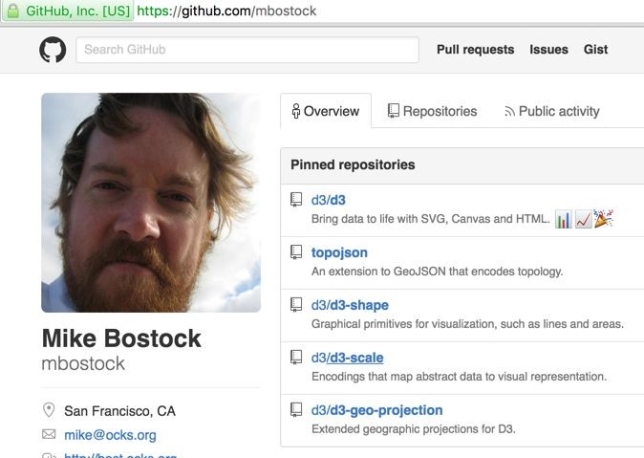
What is D3
A Labor of Love by Mike Bostock
Follow him: @mbostock

Slide 6
Examples

Slide 7
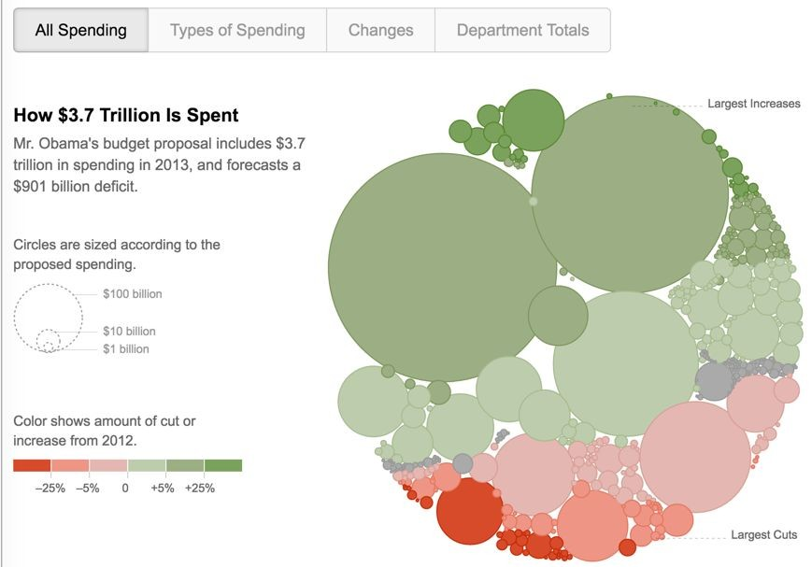
Four ways to slice Obama’s Budget (2012)
http://www.nytimes.com/interactive/2012/02/13/us/politics/2013-budget-proposal-graphic.html

Slide 8
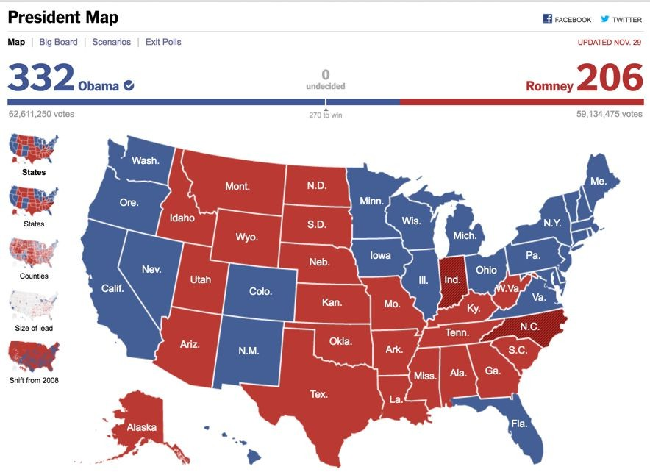
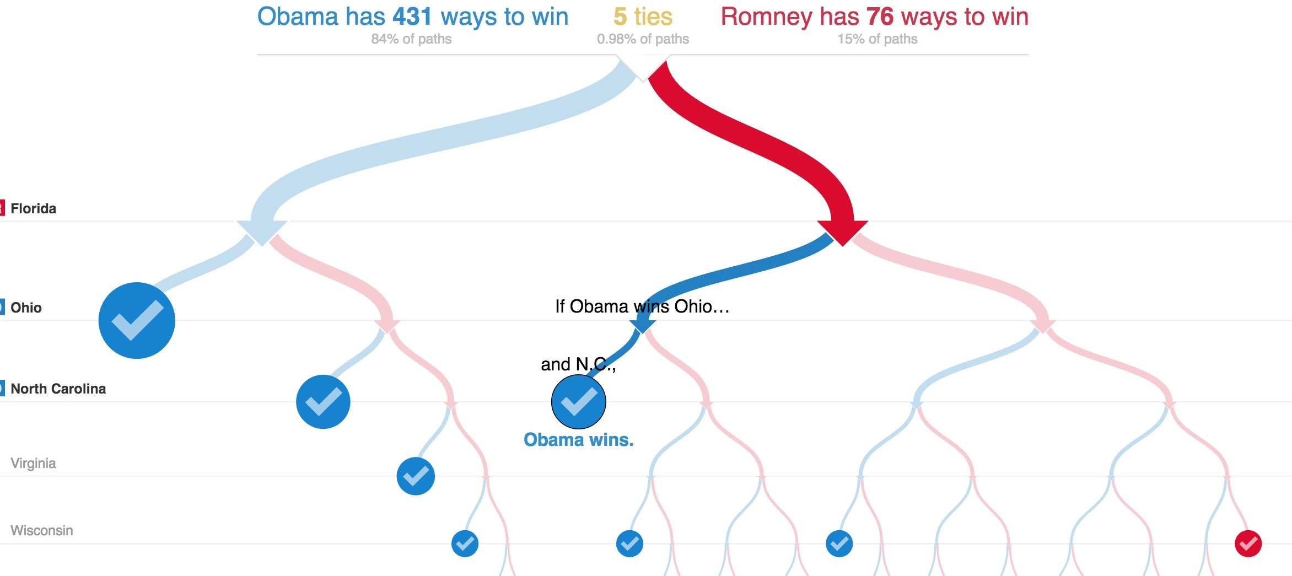
Elections 2012
http://elections.nytimes.com/2012/results/president
http://www.nytimes.com/interactive/2012/11/02/us/politics/paths-to-the-white-house.html?_r=0

Slide 9
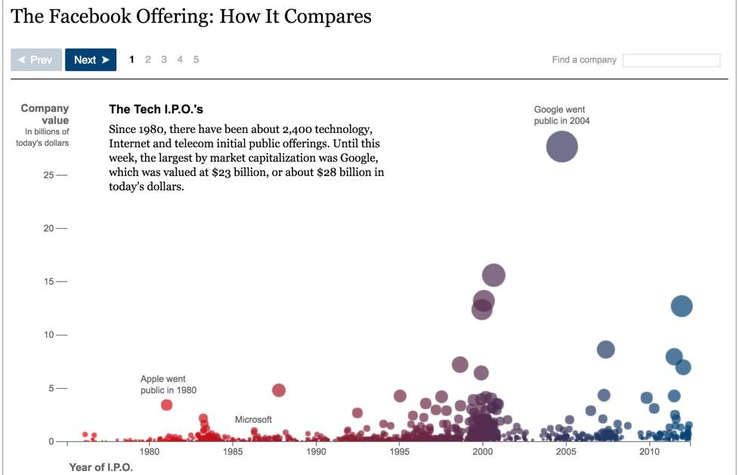
Facebook IPO
http://www.nytimes.com/interactive/2012/05/17/business/dealbook/how-the-facebook-offering-compares.html

Slide 10
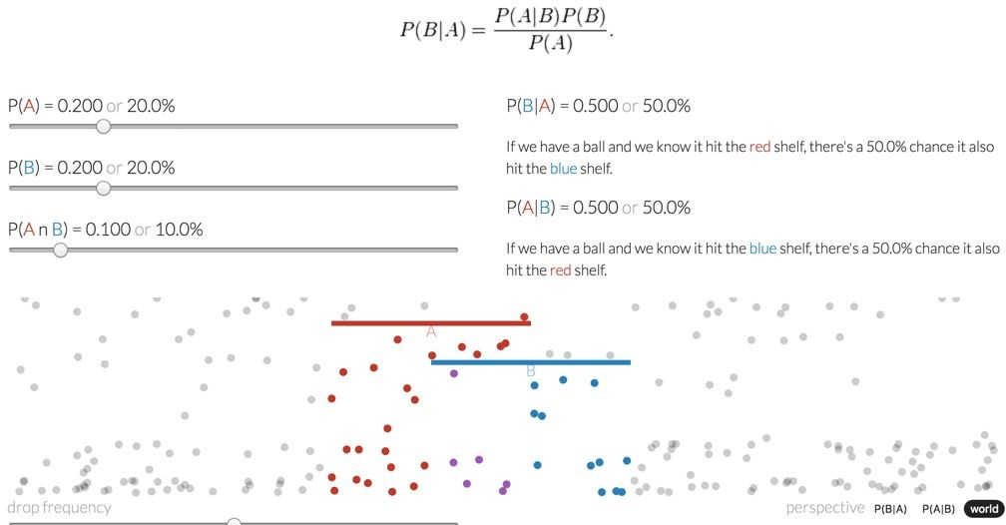
Explained Visually
http://setosa.io/ev/conditional-probability/

Slide 11
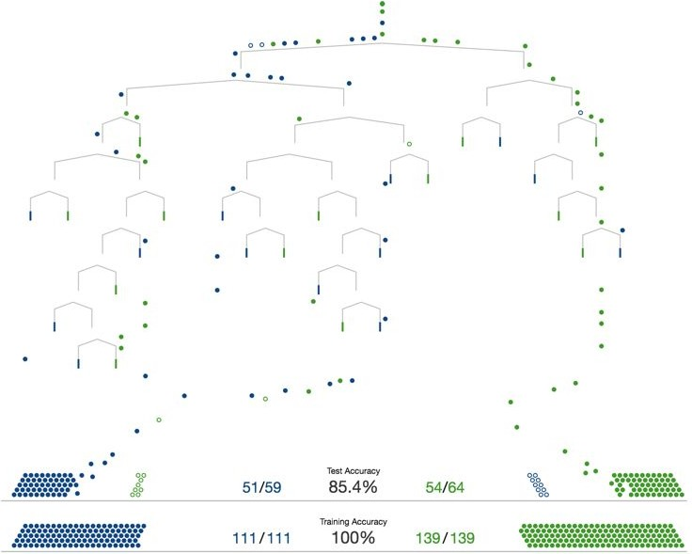
Visual Introduction to ML
http://www.r2d3.us/visual-intro-to-machine-learning-part-1/

Slide 12
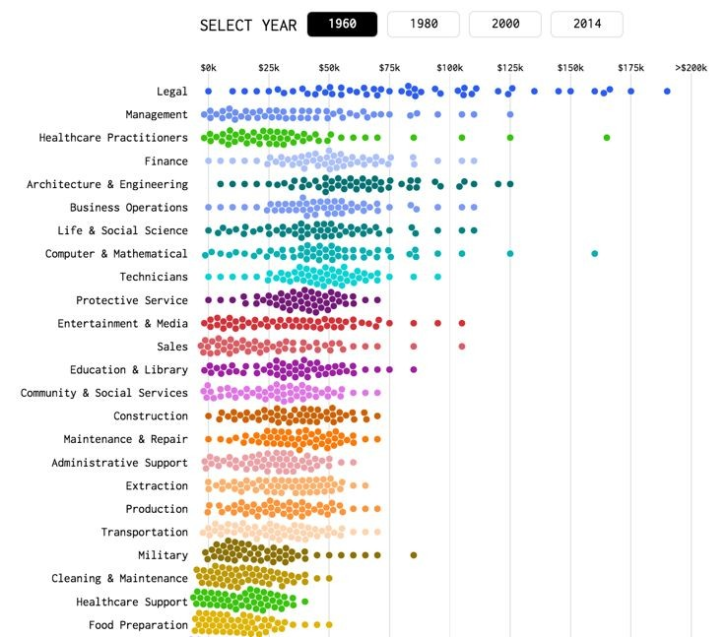
Income Changes by Profession
http://flowingdata.com/2016/06/28/distributions-of-annual-income/

Slide 13
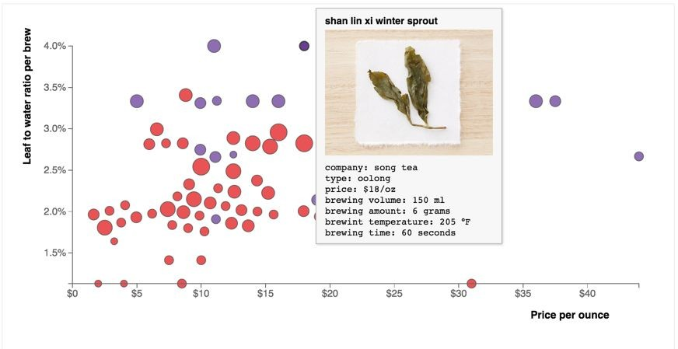
Teaswarm
https://bl.ocks.org/dhoboy/ccafe73e24cf9c36353f2641a4469314

Slide 14
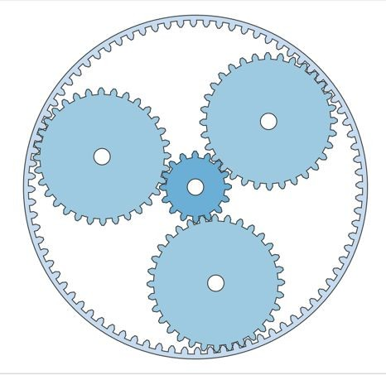
Epicyclic Gearing
https://bl.ocks.org/mbostock/1353700

Slide 15
More Select Examples
https://bost.ocks.org/mike/nations/
https://bl.ocks.org/mbostock/346f4d967650b27c0511
https://bl.ocks.org/kerryrodden/7090426
Bostock Blocks - http://bl.ocks.org/mbostock
Tons more at https://bost.ocks.org/<github_handle>

Slide 16
Design Process
http://chartsnthings.tumblr.com
http://kpq.github.io/chartsnthings/

Slide 17
What’s D3
JS library for manipulating documents based on data. D3 helps you bring data to life using HTML, SVG and CSS.
Data to Visual Elements on the HTML Document

Slide 18
Before we can get started with D3…

Slide 19
WEB Standards
HTML - Content, CSS - Style
JS - Dynamic Scripting
Data Visualization
Canvas - Paint shapes
SVG - DOM Shape elements
Web GL - 3D (Not going to talk about it)

Slide 20
Let’s learn some JS
http://jsbin.com/

Slide 21
Getting Started with D3

Slide 22
Creating SVG
svg = d3.select("#chart").append("svg")

Slide 23
Creating SVG
svg = d3.select("#chart").append("svg")

Slide 24
Selecting Elements
.selectAll(selector)
.select(selector)
Selects Elements on HTML Document

Slide 25
Append Elements
.append(element)
Appends an Child element on the page

Slide 26
Setting Attributes
.attr(properties)
Set Properties for the selected element

Slide 27
Setting Style
.style(properties)
Set Style properties (CSS) for the selected element

Slide 28
Chaining
var chart = d3.select("#chart")
.append("svg")
.attr("width", 450)
.attr("height", 300);

Slide 29
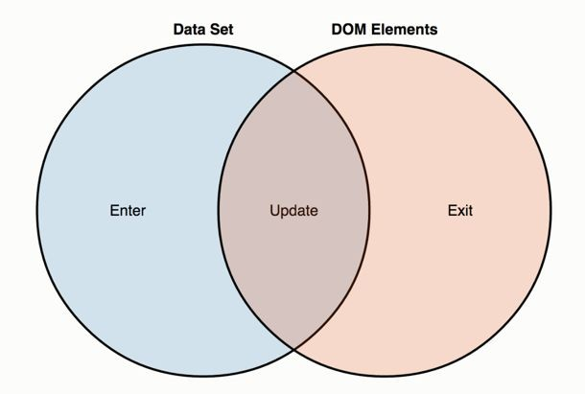
D3 Data Join

Slide 30
D3 Data Join
.data()
Binds Data to DOM Elements

Slide 31
.enter()
.enter()
Add new Elements to DOM

Slide 32
.exit()
.exit()
Removes existing elements from DOM

Slide 33
D3 Selections & General Update Pattern
Three little circles
How selections work
Thinking with joins
General Update Pattern
General Update Pattern II
General Update Pattern III
Transitions

Slide 34
There’s Lot more to D3
Scale
Axis
Layouts
Maps
Canvas Rendering
And many more...

Slide 35
D3 Examples Gallery
https://d3js.org
https://github.com/d3/d3/wiki/Gallery
http://bl.ocks.org/

Slide 36
D3 Community
http://blockbuilder.org/ (Blocks Editor)
http://kpq.github.io/ (NY Times)
http://christopheviau.com/d3list/ (Alternative D3 Gallary)
https://www.jasondavies.com/ (Maps)
http://www.meetup.com/Bay-Area-d3-User-Group/ (Bay Area D3 Meetup)

Slide 37
Alternatives
plot.ly
Bokeh Plotting Library
plottablejs.org
Tableau
Many more
But nothing beats the amazing library of examples in D3.

Slide 38
Will you love D3?
Maybe?
Some people love d3, others find it too cumbersome
Find Examples posted by Mike or others
Ask questions, it’s a supportive community

Slide 39
Just the Beginning …. of your Data Visualization Journey

